Slide 1
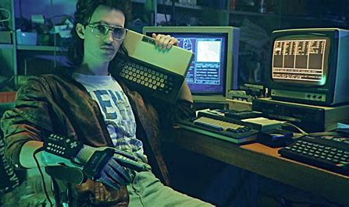
NFL Fantasy Football Mock Draft Simulator
Jayden Slotnick and Payton Glynn

